Slide 1

PRINCIPLES OF MANAGEMENT

Slide 2
Course content
MANAGEMENT ( 3rd Module ) [ 1 credit ]
1 | Introduction to Management | 01
2 | Need for Management | 02
3 | Various types of Management styles | 03
4 | Vision, Mission, Corporate Objectives, various types of Corporate Strategies | 02
5 | Business level strategies and its importance | 02
6 | Functional level strategies and its importance in creating value for the customer.
7 | Communication Process | 02
8 | Development of cases by students; Corporate Planning and implementation requirements. | 02
 | Total : | 14 hrs.

Slide 3
Management - Introduction
Management is a vital aspect of the economic life of man, which is an organised group activity.
A central directing and controlling agency is indispensable for a business concern.

Slide 4


Slide 5
Management - Definition
Management is the “art of getting things done through other people”
- Mary. Parker Follett-.

Slide 6
Case Studies
1. Google's Project Aristotle
Overview: Google's Project Aristotle was a research initiative aimed at understanding what makes teams successful. The study revealed that psychological safety—where team members feel safe to take risks and be vulnerable—was the most crucial factor in high-performing teams.
Case Study: Google found that the best teams were not necessarily the ones with the most star performers but those where team members felt comfortable speaking up, taking risks, and collaborating openly. This insight led to changes in how Google managed its teams, focusing on creating environments that fostered trust and open communication.
Key Takeaway: Effective management involves creating a supportive environment where people can work together effectively. Managers need to cultivate a culture where team members feel empowered and valued, rather than just focusing on individual performance.

Slide 7
2. Southwest Airlines' Management Style
Overview: Southwest Airlines is known for its unique management style and company culture, which emphasize employee empowerment and customer service.
Case Study: Southwest Airlines' management approach includes hiring for attitude, training for skills, and providing employees with the freedom to make decisions that improve customer service. The airline's leaders empower employees to go above and beyond to satisfy customers, which has resulted in high employee morale and excellent customer service.
Key Takeaway: Effective management involves empowering employees to make decisions and take ownership of their work. By trusting employees and giving them the tools and authority to act, managers can achieve higher levels of performance and satisfaction.

Slide 8
3. Toyota's Lean Manufacturing System
Overview: Toyota's lean manufacturing system, also known as the Toyota Production System (TPS), is a management philosophy that focuses on continuous improvement and efficiency.
Case Study: Toyota's approach involves involving all employees in the process of identifying and solving problems. Managers at Toyota encourage team members to suggest improvements and participate in problem-solving, which has led to significant gains in efficiency and quality.
Key Takeaway: Management that involves employees in the decision-making process and values their input can drive significant improvements in performance. By leveraging the collective knowledge and experience of the team, managers can achieve better results and foster a culture of continuous improvement.

Slide 9
Management - Definition
According to James L Lundy - "Management is principally the task of planning, coordinating, motivating and controlling the efforts of others towards a specific objective".
In the words of Henry Fayol - "To manage is to forecast and to plan, to organise, to command, to co-ordinate and to control".
According to Peter F Drucker - "Management is a multi-purpose organ that manages a business and manages managers and manages worker and work".

Slide 10
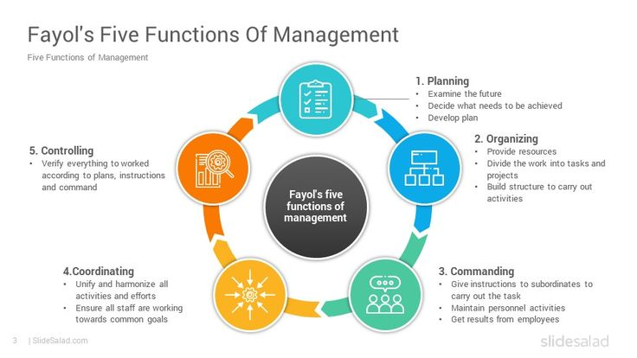

Slide 11
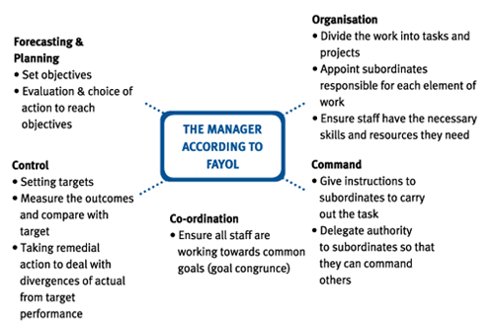

Slide 12
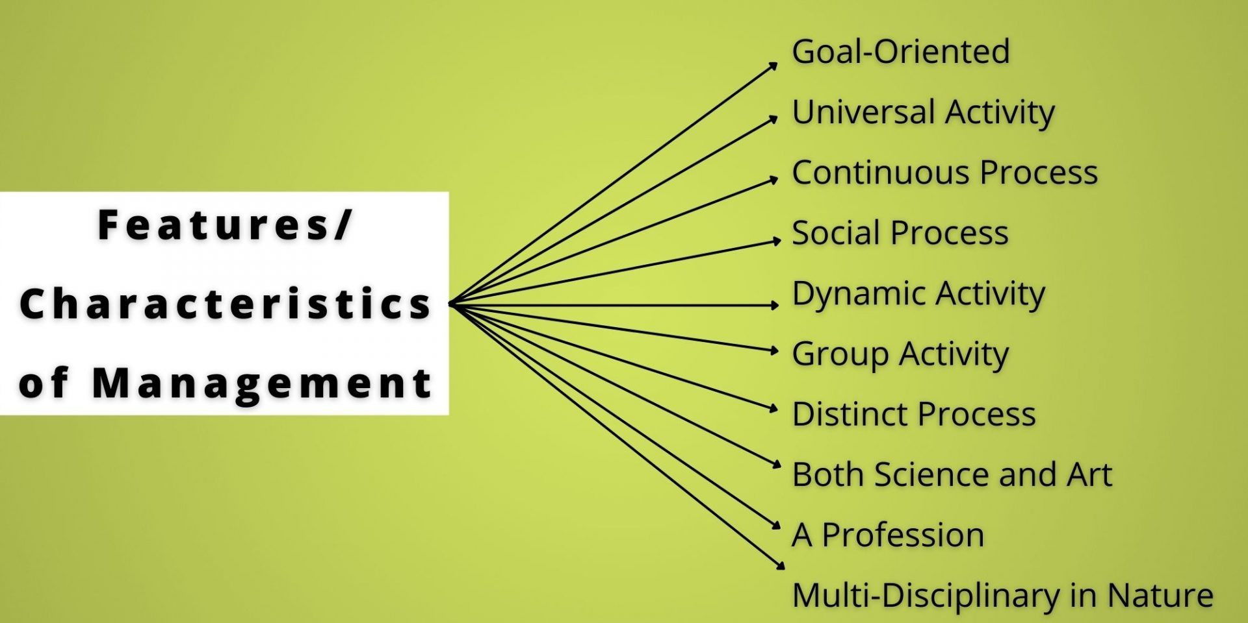

Slide 13
Let's explore examples and a case study that illustrates each of the characteristics of management you mentioned:
Management is Goal-Oriented:
  Example: A retail company sets a goal to increase its market share by 15% in the next fiscal year. Management works on strategies such as launching new marketing campaigns, improving customer service, and optimizing inventory to achieve this goal.
Management is a Universal Activity:
  Example: The principles of management are applicable in various industries and geographical locations. For instance, the principles of planning, organizing, leading, and controlling are universal and can be applied in a manufacturing plant in Asia as well as a tech startup in North America.
Management is a Continuous Process:
  Example: In a software development company, project managers continuously plan, execute, monitor, and adapt their processes to meet changing client requirements and market demands. This ongoing cycle is a continuous management process.
Management is Dynamic and Not Static:
  Example: An e-commerce company regularly adapts its business strategies based on changes in consumer behavior, technological advancements, and competitive landscape. The management team needs to be dynamic and responsive to external factors.
Management is a Science as well as an Art:
  Example: The application of management theories (science) combined with the creativity and intuition of managers (art) is evident in product development. The use of project management methodologies (science) alongside creative problem-solving (art) contributes to successful outcomes.

Slide 14
6. Management is a Profession:
  Example: Professional certifications such as Project Management Professional (PMP) or Certified Public Accountant (CPA) reflect the professionalization of management. Individuals holding these certifications are recognized as competent and qualified managers in their respective fields.
7. Management is a System of Authority:
  Example: In a military organization, there is a clear hierarchical structure with a chain of command. Orders flow from the top-down, and authority is delegated based on the organizational structure.
8. Management Involves Decision-Making:
  Example: A CEO deciding whether to invest in a new technology or expand into a new market involves strategic decision-making. This decision impacts the entire organization and requires careful consideration of risks and benefits.
9. Management Implies Good Leadership:
  Example: A team leader in a software development company provides guidance, motivation, and support to team members. Effective leadership ensures that the team stays focused, motivated, and delivers high-quality products.
10. Management is Intangible:
  Example: The effective coordination and communication within a virtual team are intangible aspects of management. These elements are crucial for the team's success but may not be physically observed.
11. Management is Required at Different Levels:
  Example: In a large manufacturing company, top-level executives focus on strategic decisions (e.g., expansion plans), middle-level managers coordinate activities within departments, and frontline supervisors ensure day-to-day operations run smoothly.

Slide 15
Case Study: Dynamic Management in a Tech Startup:
Consider a tech startup that aims to develop innovative software solutions. The CEO sets a goal to become a market leader within three years. The management team continuously adapts to the dynamic tech landscape, making decisions on product development, marketing strategies, and talent acquisition. The startup applies a combination of scientific methodologies (Agile project management) and artistic elements (creative problem-solving) to navigate uncertainties. Leadership is crucial for inspiring the team, and the startup's success relies on the continuous, intangible, and universal nature of effective management across different levels within the organization.

Slide 16
CHARACTERISTICS OF MANAGEMENT
Management is goal oriented:
Every managerial activity has certain objectives.
Management deals particularly with the actual directing of human efforts.
Management is a purposeful activity.
It is concerned with the achievement of pre-determined objectives of an organisation.

Slide 17
CHARACTERISTICS OF MANAGEMENT
Management is a universal activity:
Management does not apply to business undertakings only.
It applies to political, social, religious, and educational institutions also.

Slide 18
CHARACTERISTICS OF MANAGEMENT
Management is a continuous process:
Management is a process, function or activity.
This process continues till the objectives set by administration are actually achieved.
"Management is a social process involving co-ordination of human and material resources through the functions of planning, organising, staffing, leading and controlling in order to accomplish stated objectives".

Slide 19
CHARACTERISTICS OF MANAGEMENT
Management is dynamic and not static:
The principles of management are dynamic and not static.
It has to adopt itself according to social changes.
Management draws ideas and concepts from various disciplines: Management is an interdisciplinary study.
It draws ideas and concepts from various disciplines like economics, statistics, mathematics, psychology, sociology, anthropology etc

Slide 20
CHARACTERISTICS OF MANAGEMENT
Management is a Science as well as an Art:
Management is a science because there are definite principles of management.
It is also an art because by the application of these principles predetermined objectives can be achieved

Slide 21
CHARACTERISTICS OF MANAGEMENT
Management is a Profession:
Management is gradually becoming a profession because there are established principles of management which are being applied in practice, and it involves specialised training and is governed by ethical code arising out of its social obligations.

Slide 22
CHARACTERISTICS OF MANAGEMENT
Management is a system of authority:
Authority means power to make others act in a predetermined manner.
Management formalises a standard set of rules and procedure to be followed by the subordinates and ensures their compliance with the rules and regulations.
Since management is a process of directing men to perform a task, authority to extract the work from others is implied in the very concept of management.

Slide 23
CHARACTERISTICS OF MANAGEMENT
Management involves decision-making:
Management implies making decisions regarding the organisation and operation of business in its different dimensions.
The success or failure of an organisation can be judged by the quality of decisions taken by the managers.
Therefore, decisions are the key to the performance of a manager.

Slide 24
CHARACTERISTICS OF MANAGEMENT
Management implies good leadership:
A manager must have the ability to lead and get the desired course of action from the subordinates.
Management of the high order implies the capacity of managers to influence the behaviour of their subordinates.

Slide 25
CHARACTERISTICS OF MANAGEMENT
Management is intangible:
It cannot be seen with the eyes.
It is evidenced only by the quality of the organisation and the results i.e., profits, increased productivity etc.
Different Levels of Management:
Management is needed at different levels of an organisation namely top level, middle level and lower level.

Slide 26
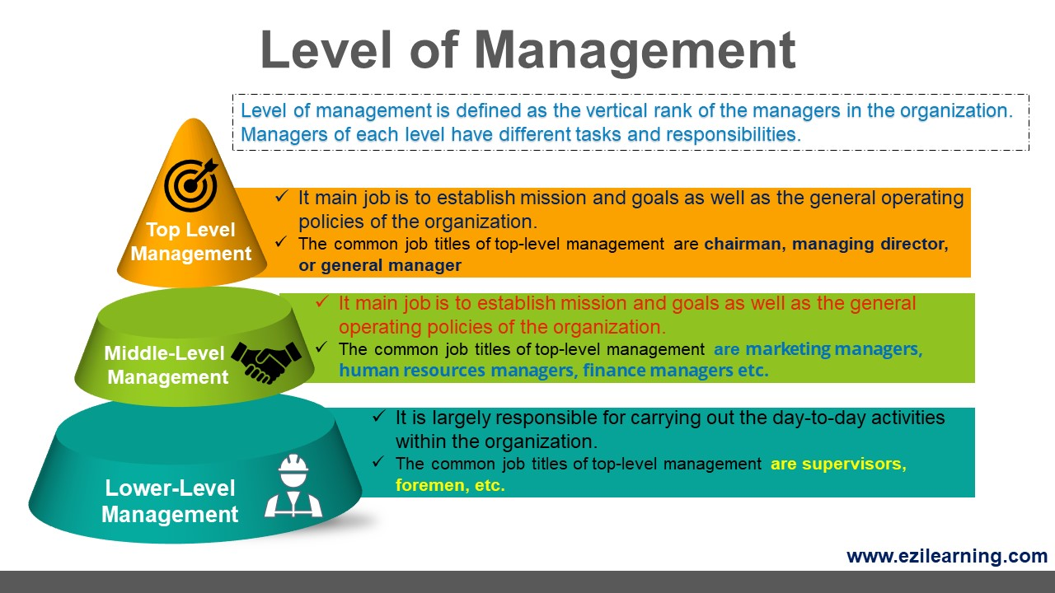

Slide 27
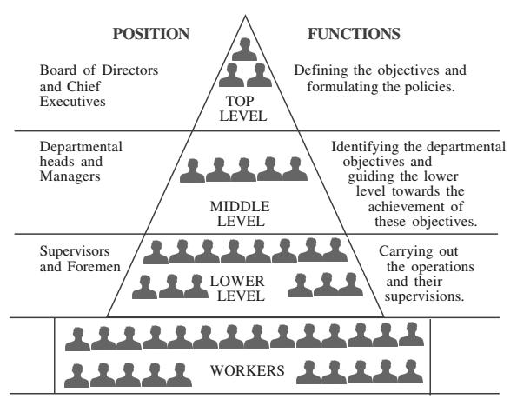

Slide 28
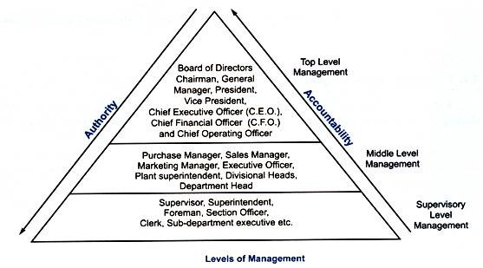

Slide 29
In a typical organizational structure, management is divided into three main levels: top level, middle level, and lower level. Each level has its own set of responsibilities and functions. Here's an example using a hypothetical company:
Top Level Management:
  Position: CEO (Chief Executive Officer)
  Responsibilities:
    Setting overall company goals and objectives.
    Formulating policies and strategies for the entire organization.
    Making high-level decisions that affect the entire company.
    Representing the organization to external stakeholders.
Middle-Level Management:
  Position: Regional Manager
  Responsibilities:
    Implementing the policies and strategies set by top-level management.
    Coordinating activities between different departments.
    Overseeing the work of lower-level managers.
    Translating top-level goals into actionable plans for specific regions or departments.

Slide 30
3. Lower Level Management:
  Position: Team Supervisor
  Responsibilities:
    Managing day-to-day operations within a specific team or department.
    Assigning tasks to employees and ensuring they are completed.
    Providing feedback and guidance to employees.
    Reporting to middle-level management on the team's performance.
These three levels form a hierarchical structure where top-level management focuses on long-term strategic planning, middle-level management handles coordination and implementation, and lower-level management is responsible for the execution of daily tasks within specific teams or departments. Each level plays a crucial role in the overall functioning and success of the organization.

Slide 31


Slide 32
SCOPE OF MANAGEMENT
    Subject-matter of Management Management is considered as a continuing activity made up of basic management functions like planning, organizing, staffing, directing and controlling. These components form the subject-matter of management.
    Functional Areas of Management
    Financial Management: Financial management includes forecasting, cost control, management accounting, budgetary control, statistical control, financial planning etc.
    Human Resource Management: Personnel / Human Resource Management covers the various aspects relating to the employees of the organisation such as recruitment, training, transfers, promotions, retirement, terminations, remuneration, labour welfare and social security, industrial relations etc.
    Marketing Management: Marketing management deals with marketing of goods, sales promotion, advertisement and publicity, channels of distribution, market research etc.

Slide 33
SCOPE OF MANAGEMENT
Production Management: Production Management includes production planning, quality control and inspection, production techniques etc.
Material Management: Material management includes purchase of materials, issue of materials, storage of materials, maintenance of records, materials control etc.
Purchasing Management: Purchasing management includes inviting tenders for raw materials, placing orders, entering into contracts etc.
Maintenance Management: Maintenance Management relates to the proper care and maintenance of the buildings, plant and machinery etc.
Office Management: Office management is concerned with office layout, office staffing and equipment of the office.

Slide 34
Management is both a Science as well as an Art

Slide 35
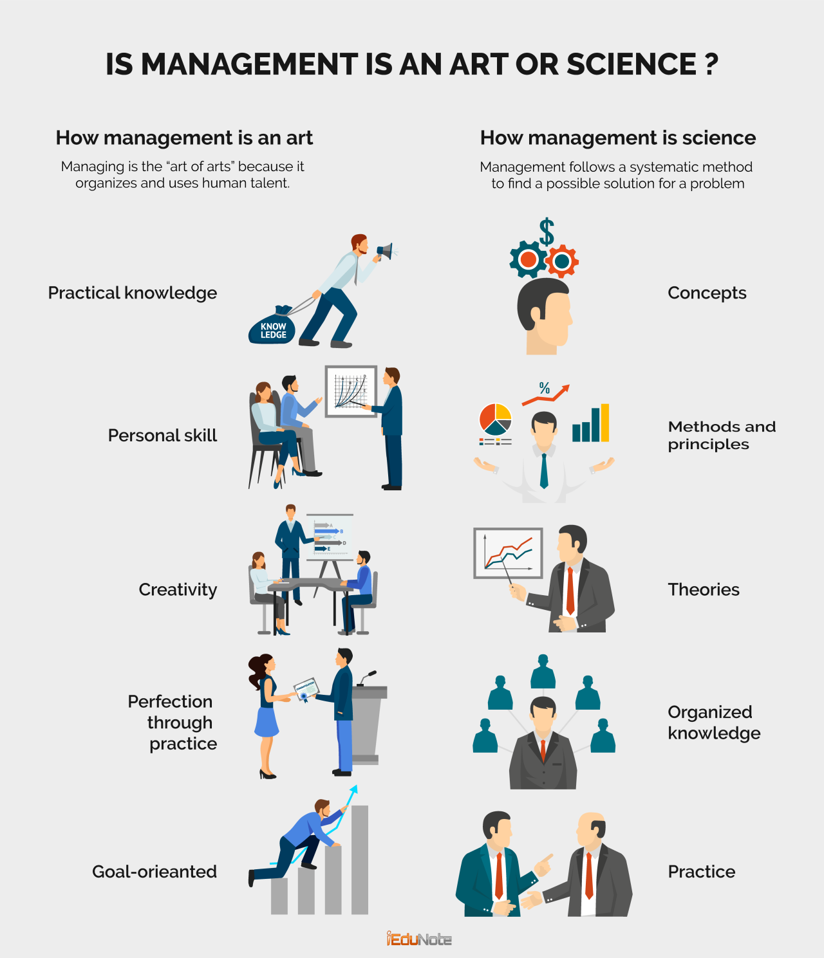

Slide 36
The idea that management is both a science and an art suggests that it involves systematic principles and techniques (science) as well as creative and intuitive skills (art). Let's explore this duality with an example:
Management as a Science: Management as a science involves the systematic application of principles, theories, and methodologies to achieve specific objectives. This aspect emphasizes the use of data, analysis, and established frameworks.
Example: Consider a manufacturing company implementing Total Quality Management (TQM) principles. TQM is a systematic management approach that focuses on continuous improvement, customer satisfaction, and employee involvement. The company uses statistical methods, quality control tools, and standardized processes to enhance product quality. This scientific approach helps in measuring and improving performance based on data and empirical evidence.
Management as an Art: Management as an art involves the creative and intuitive application of skills to navigate complex and unpredictable situations. This aspect highlights the need for flexibility, innovation, and adaptability in decision-making.
Example: Now, imagine the same manufacturing company faces a sudden disruption in the supply chain due to unforeseen circumstances. The management team must creatively and intuitively respond to the situation. This could involve quick decision-making, thinking outside the box to find alternative suppliers, and effectively communicating changes to the workforce. The ability to handle such unforeseen challenges requires artistic skills such as leadership, creativity, and strategic thinking.

Slide 37
Synthesis of Science and Art in Management: In practice, effective management often involves a seamless integration of scientific principles and artistic skills. For instance, a manager may use data and analytics to identify trends and make informed decisions (science), but they also need interpersonal skills to lead and motivate their team (art). Striking the right balance between these elements is crucial for successful management.
Example: A marketing manager developing a new advertising campaign uses market research and analytics (science) to identify target demographics and optimal channels. However, the creative aspect of designing engaging and visually appealing advertisements, as well as understanding the emotional appeal that resonates with the audience, involves artistic skills.
In summary, management as both a science and an art acknowledges the need for systematic approaches and creative, intuitive skills in achieving organizational goals. The successful manager combines the best of both worlds, using data-driven decision-making alongside creative problem-solving to navigate the complexities of the business environment.

Slide 38
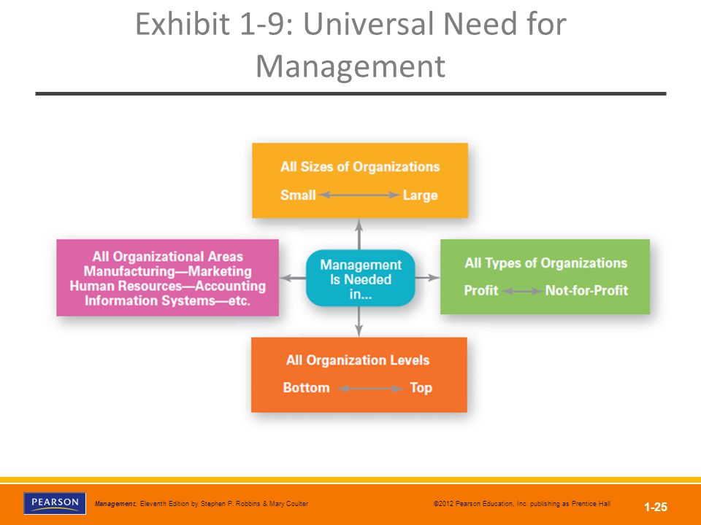

Slide 39
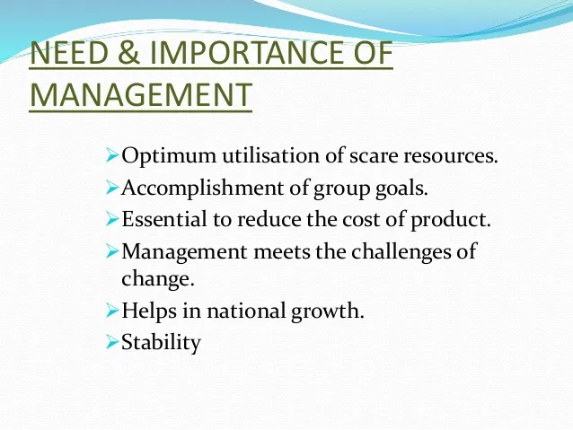

Slide 40
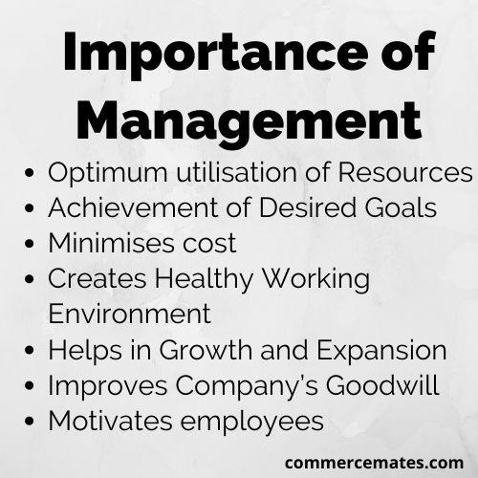

Slide 41
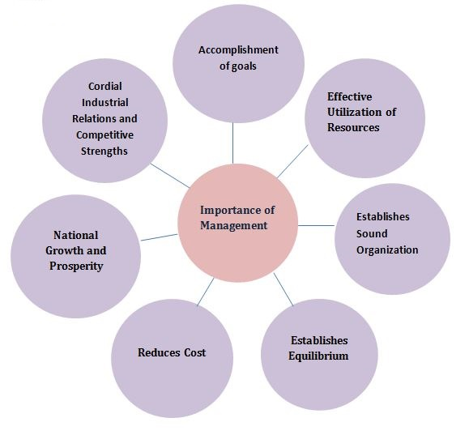

Slide 42
THANK YOU……………..

Slide 43
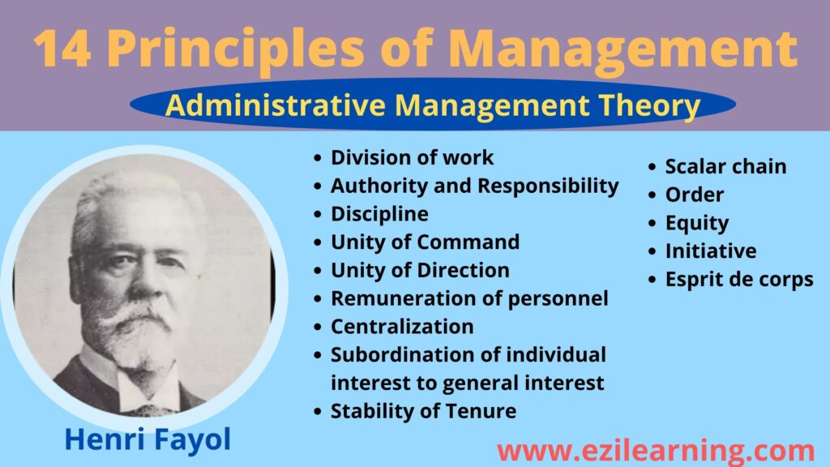
Notes:
READING ASSIGNMENT

